Slide 1
Greek – Korean Chamber of Commerce

Slide 2
Contents
Ⅰ
Overview of Seoul Food 2014
Ⅱ
Review of Seoul Food 2013
Ⅲ
Exhibition Stand Fittings

Slide 3
Overview of Seoul Food 2014
Dates | 5. 13(Tue) ~ 5. 16(Fri) [4 Days]
Edition | 32nd
Scale | 64,831sq.m
Exhibition Composition
Venue | KINTEX Hall 1,2,3,4,5,7
Target Goal | 1,450 Exhibitors (Domestic 950, Overseas 500) 2,500 Booths (Domestic 1,800, Overseas 700)
Events | Global Food Plaza, Culinary Demonstration, Cooking Concert, K-Food Seminar etc.
SEOUL FOOD 2014
SEOUL FOOD & HOTEL
SEOUL FOODTECH
SEOUL PACK
SEOUL INT’L CULINARY ACADEMY

Slide 4
Overview of Seoul Food 2014
Hall 1-5, 7
by KOTRA
Hall 9-10
by Ministry for Food, Agriculture, Forestry and Fisheries
Hall 1,2,3 | Hall 4,5 | Hall 7
SEOUL FOODTECH SEOUL PACK | SEOUL FOOD&HOTEL (DOMESTIC & INTERNATIONAL) | SEOUL FOOD&HOTEL (DOMESTIC) SEOUL CULINARY ACADEMY

Slide 5
Review of Seoul Food 2013
■ Commencement Year : 1983
■ The Third-Largest Food Exhibition in Asia
■ Facts & Figures
Segment | 2011 | 2012 | 2013 | 2014
Exhibition Space (㎡) | 53,541 | 64,766 | 64,831 | 64,831
Exhibitors | 1,102 | 1,155 | 1,210 | 1,450
Booths | 2,125 | 2,333 | 2,308 | 2,500
Visitors | 45,331 | 49,156 | 51,974 | 55,000

Slide 6
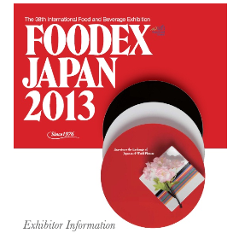
Review of Seoul Food 2013
■ Seoul Food’s Status
■ Comparison between Asia’s Major Food Exhibitions
Segment | Foodex Japan Tokyo 2013 | Food&Hotel Asia Singapore 2012 | Seoul Food 2013
Exhibition Space (㎡) | 54,000㎡ | 92,000㎡ | 64,831㎡
Exhibitors | 2,544 | 2,845 | 1,210
Visitors | 71,536 | 60,707 | 51,974

Slide 7
Review of Seoul Food 2013
■ A Steady Growth Course with Seoul Food
Seoul Food 2013 was yet another record-breaking success:
■ 21.1% increase in International Pavilion space
■ 4.8% increase in total exhibitors
■ 29% increase in International Pavilion booths
■ 5.7% increase in total visitors
■ 2.5% increase in visitor countries
The industry and its internationality are continuing apace: The success story of Seoul Food continues!

Slide 8
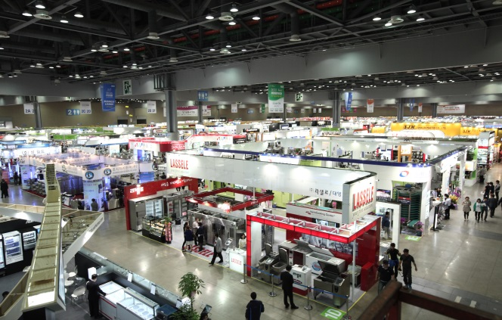
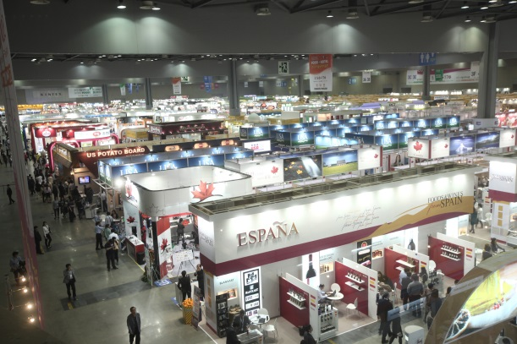
Review of Seoul Food 2013
■ Exhibitor Information
Number of Exhibiting Countries | 41 | +4.8% compared to 2012
Total Number of Exhibitors | 1,210
Number of Domestic Exhibitors | 660
Number of International Exhibitors | 550
Domestic Pavilion
International Pavilion

Slide 9
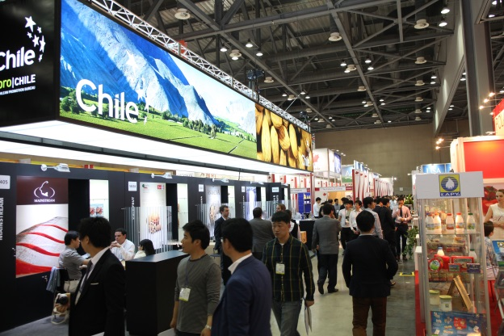
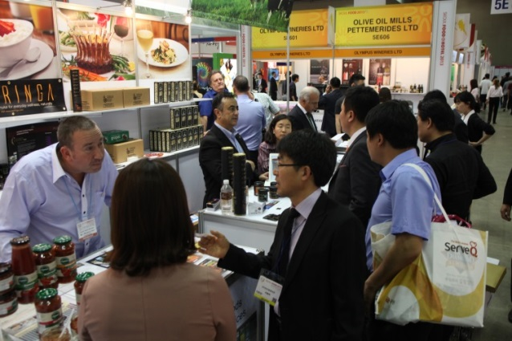
Review of Seoul Food 2013
■ Nationalities of Exhibitors
Country | Exhibitors | Booths
China | 170 | 184
USA | 40 | 62
Taiwan | 27 | 32
Thailand | 35 | 32
Spain | 25 | 28
Canada | 21 | 26
Turkey | 15 | 24
Mexico | 10 | 20
Japan | 22 | 18
Germany | 9 | 16
Poland | 20 | 12
Vietnam | 11 | 12
Philippines | 12 | 10
Colombia | 10 | 10
Chile | 9 | 10
New Zealand | 8 | 10
Seoul Food 2013 had more overseas exhibitors than ever before

Slide 10
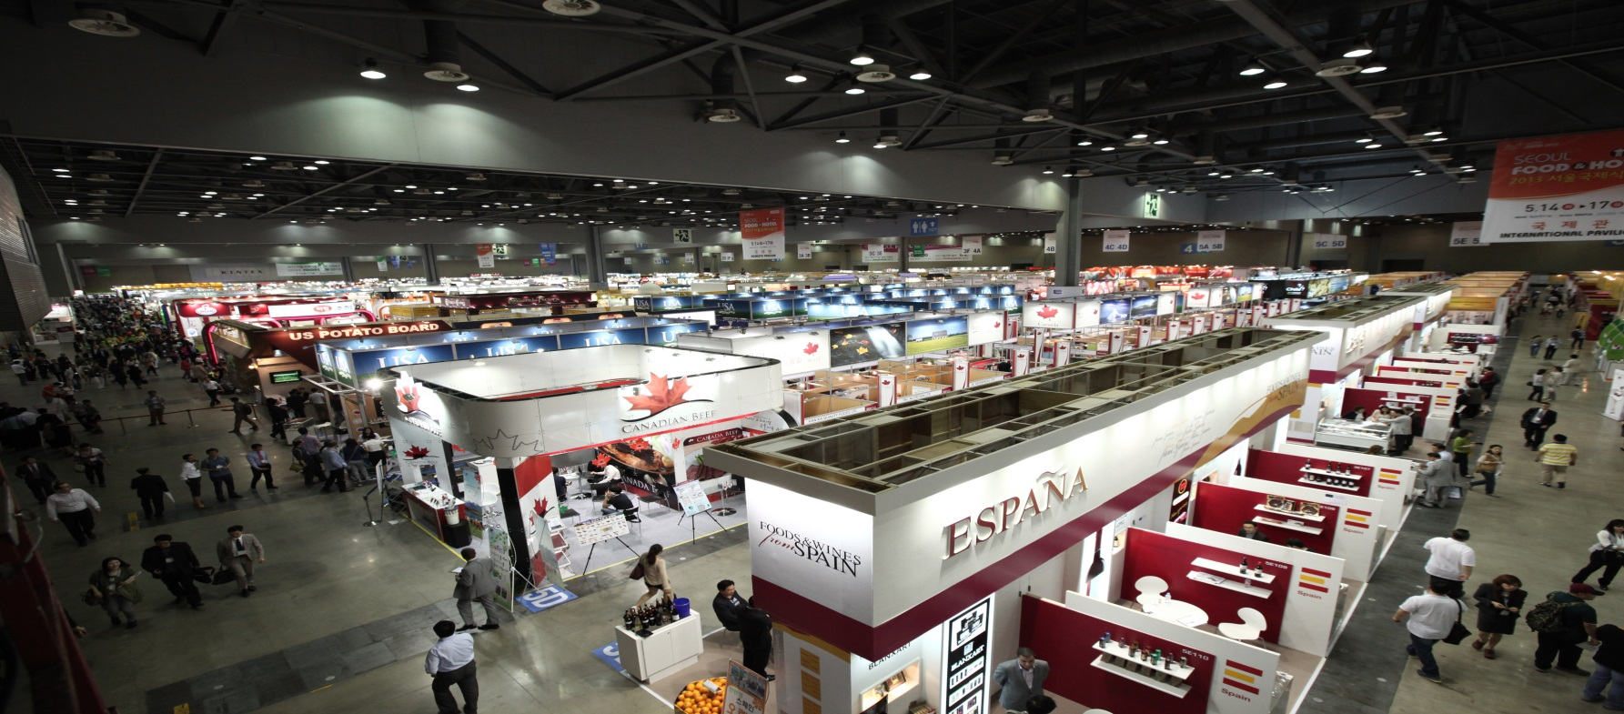
Review of Seoul Food 2013
■ Booth Information
Total Number of Booths | 2,308 | -1.02% compared to 2012
Number of Booths in Domestic | 1,679
Number of Booths in International | 629
International Pavilion

Slide 11
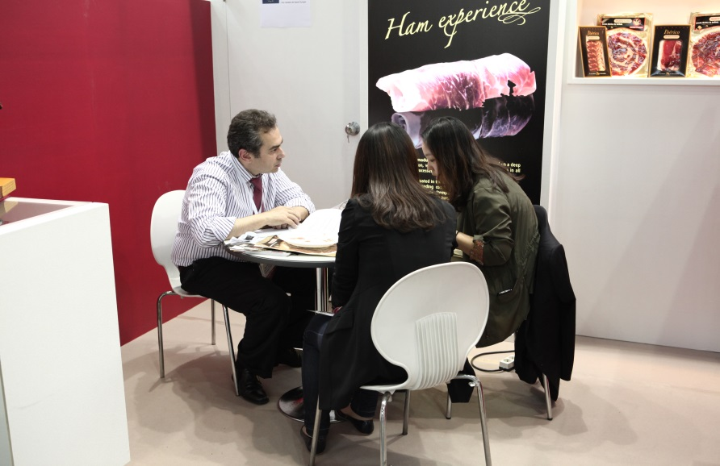
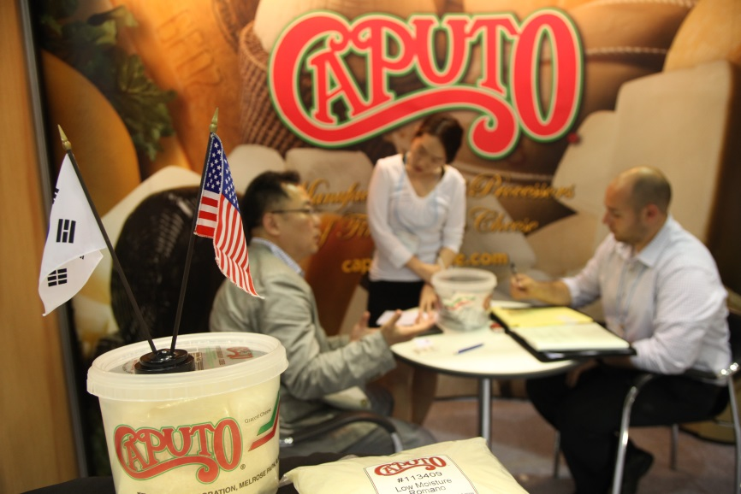
Review of Seoul Food 2013
■ Visitor Information
Number of Visiting Countries | 81 | +5.7% compared to 2012
Total Number of Visitors | 51,974
Number of Domestic Visitors | 48,808
Number of International Visitors | 3,166

Slide 12
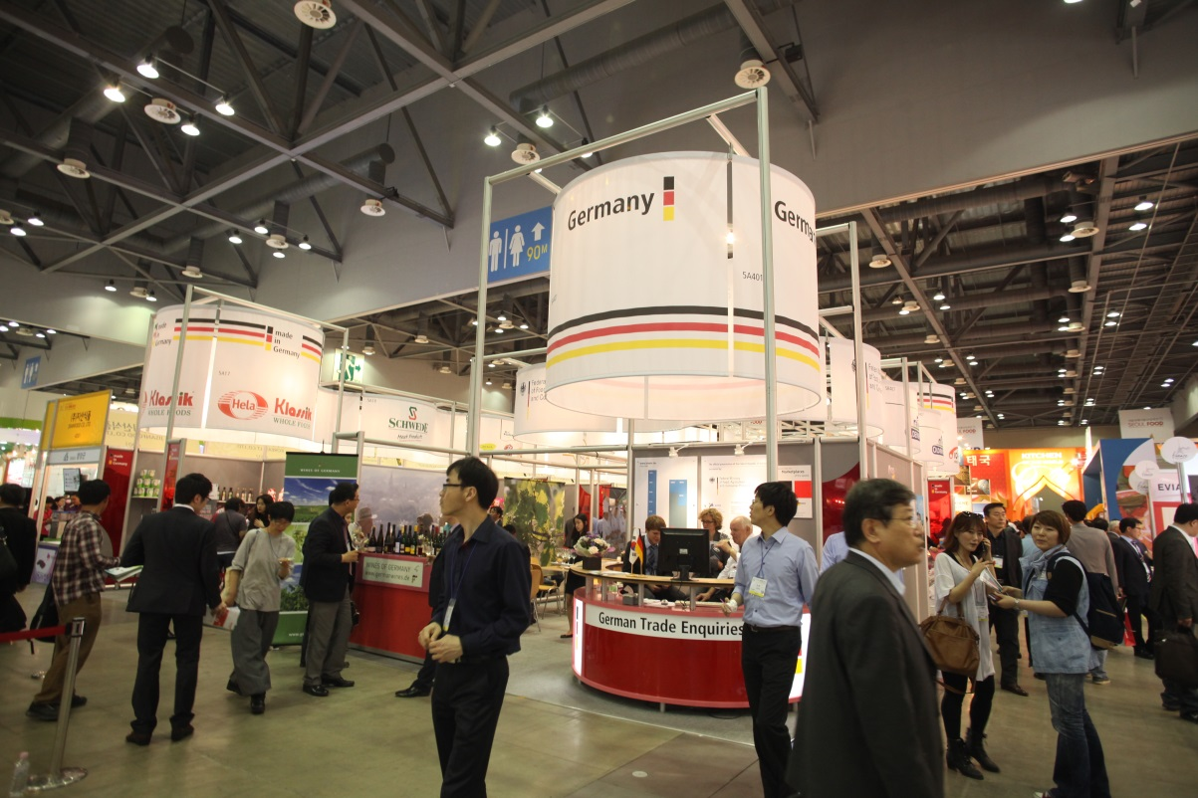
Review of Seoul Food 2013
■ Exhibition Space
Total Exhibition Space | 64,831 sqm | +1.0% compared to 2012
Domestic Pavilions | 50,314 sqm
International Pavilion | 14,517 sqm

Slide 13
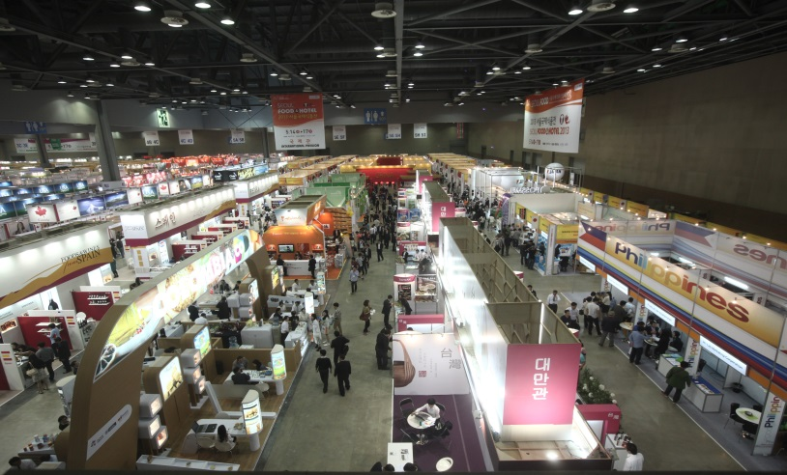
Review of Seoul Food 2013
■ Exhibitor Analysis
Overall Assessment of Exhibitor (in %)
Willingness to Recommend (in %)
Intention to Participate in the Future (in %)

Slide 14
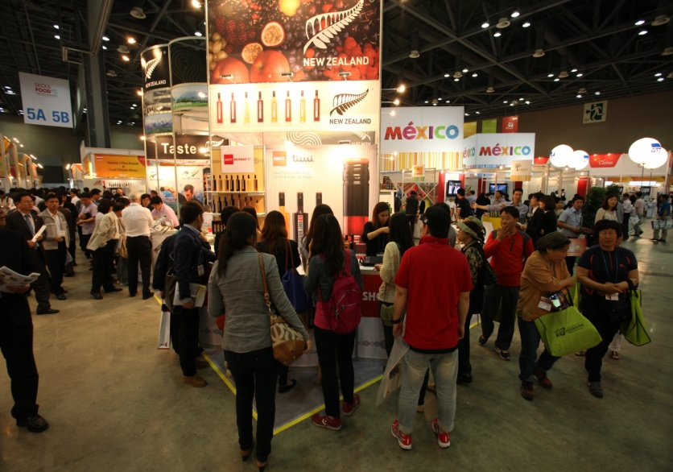
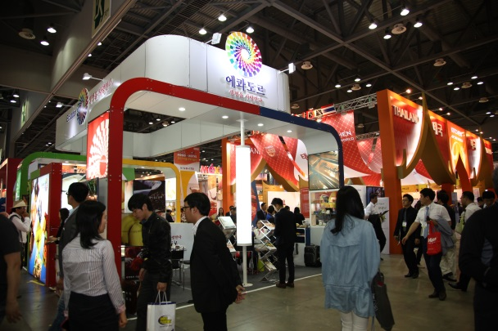
Review of Seoul Food 2013
■ Exhibitor Analysis
Achievement of Exhibitor Objectives (in %)
General Assessment of Exhibition (in %)

Slide 15
Review of Seoul Food 2013
■ Areas of Interested to Visitors
Visitors by Exhibition Hall (in %)*
Food Mac Pavilion
Food Pack Pavilion
Processing Machinery | 36
Food IT Equipment | 16
Kitchen Appliances∙Furniture | 13
Kitchen & Restaurant Machinery | 12
Bakery & Confectionery Equipment | 11
Catering Service | 8
Food Transportation Equipment | 4
Packaging Materials / Container | 36
Packaging Machinery / Component | 27
Packaging Processing | 18
Packaging Related Machinery | 12
Packaging Related Service | 8
Food Safety Pavilion
Sanitation Equipment | 48
Preservation Technology | 29
Inspection & Analysis Machinery | 20
Floor Safety | 4
* These sections of the survey allowed for multiple selections.

Slide 16
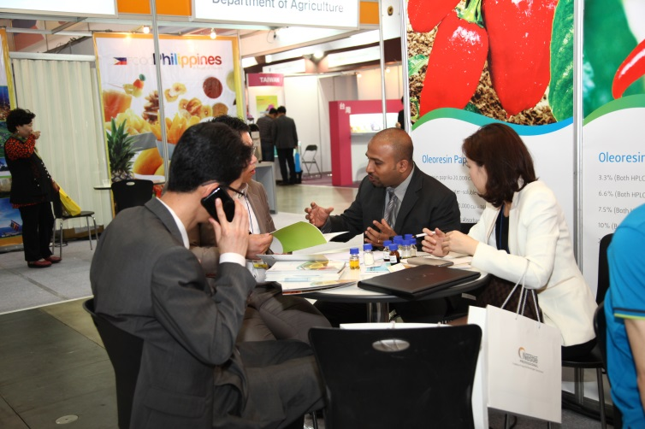
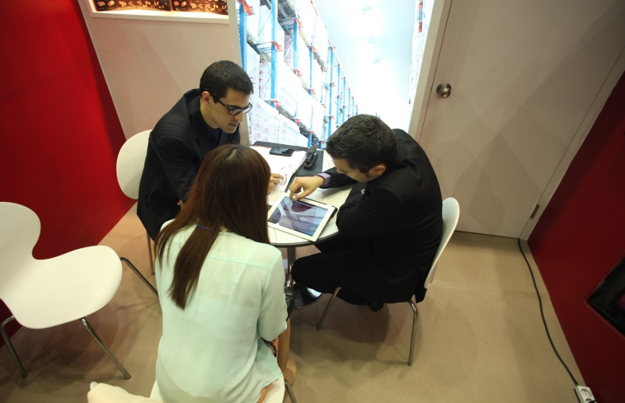
Review of Seoul Food 2013
■ Areas of Interested to Visitors
Visitors by Exhibition Hall (in %)*
Food & Hotel Pavilion
Agricultural Products | 17
Ingredients & Additives | 10
Coffee & Tea | 10
Livestock | 9
Bakery & Confectionery | 9
Seafood Products | 9
Health & Organic | 7
Food Information | 7
Dairy | 6
Franchise | 5
Beverage | 5
Traditional Food | 3
Poultry | 2
Catering Service | 2
* These sections of the survey allowed for multiple selections.

Slide 17
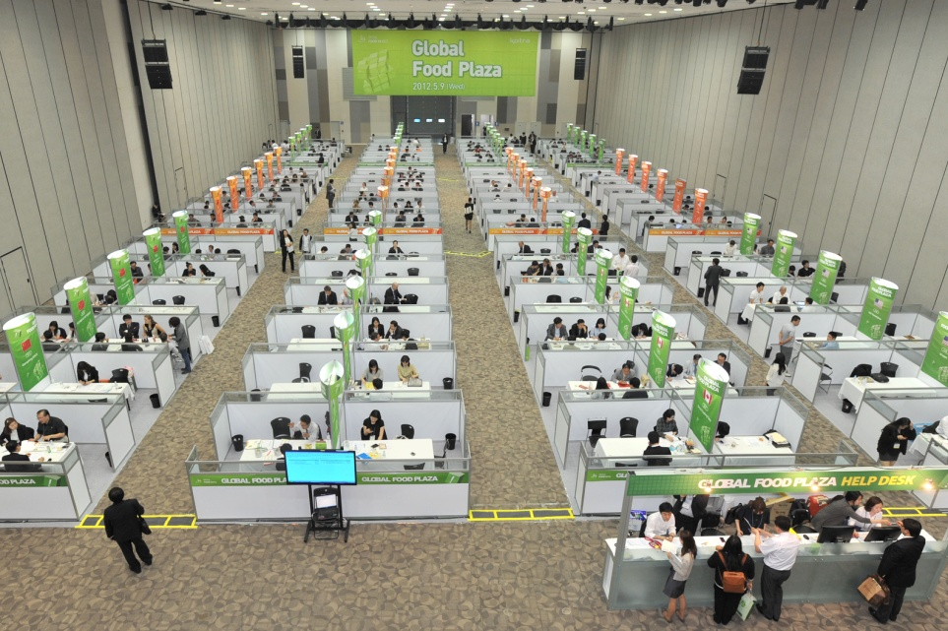
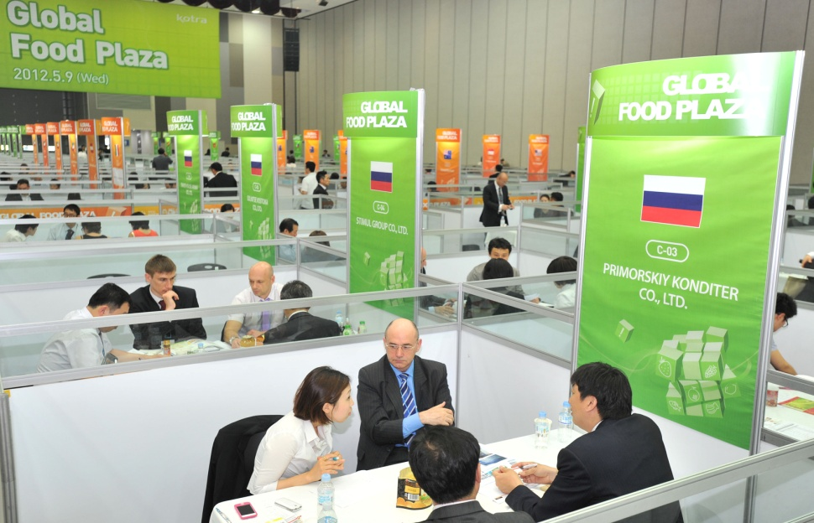
Review of Seoul Food 2013
■ Global Food Plaza
Number of Participating Countries | 19
Number of Invited Companies | 87
Number of Conducted Meetings | 1,036
Number of Concluded Deals | Worth US$320 million

Slide 18
Exhibition Stand Fittings
■ Stand Packages
Space Only | Walk on Stand | Premium Stand
€310/sqm | €390/sqm | €450/sqm
1 booth=9㎡(3mx3m) €310/m x 9㎡ €2,790/booth *Minimum 18㎡ | 1 booth=9㎡(3mx3m) €390/m x 9㎡ €3,510/booth *Minimum 9㎡ | 1 booth=9㎡(3mx3m) €450/m x 9㎡ €4,050/booth *Minimum 18㎡
Features - | walls, carpet, spotlight, fluorescent lights, power point, chairs, Info counter, table, fascia, shelves | walls, carpet, spotlight, fluorescent lights, power point, chairs, counter, table, fascia, lockable cupboard display cube, shelves
* Features and specification are subject to change without notice.
* Official stand fitting contractor’s contact details to be advised later.

Slide 19
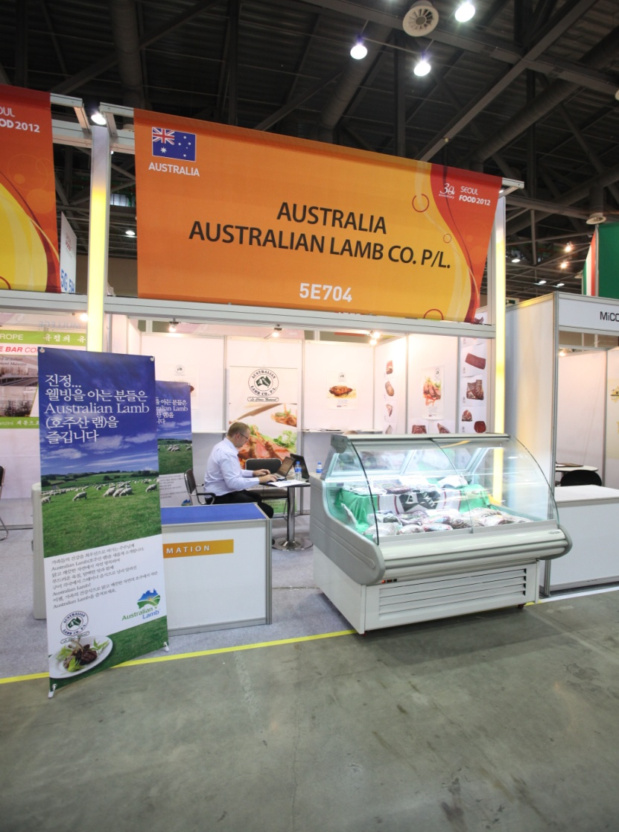
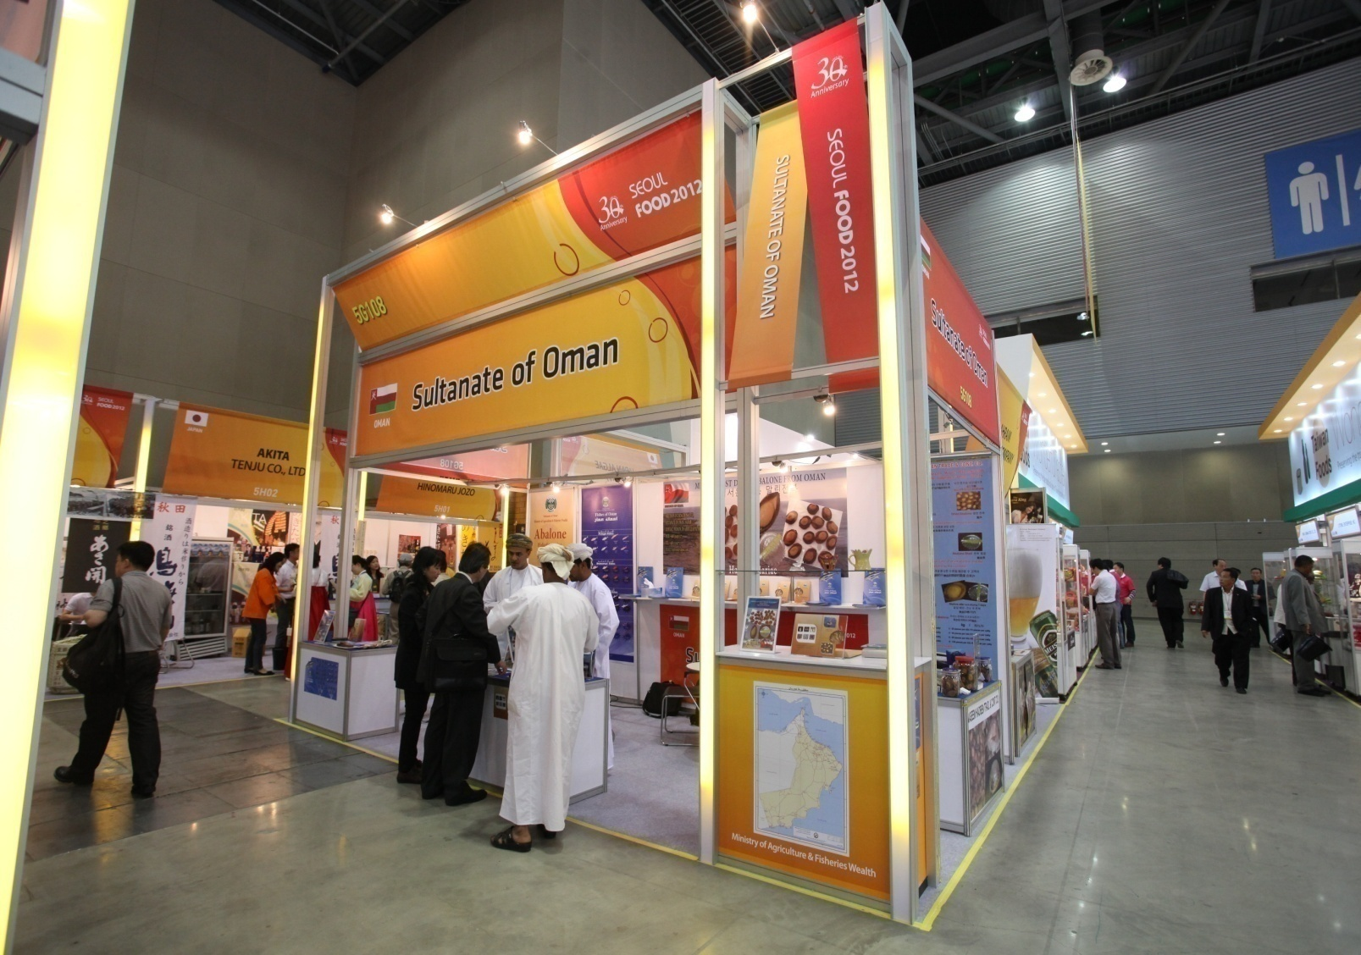
Exhibition Stand Fittings
■ Walk on Stand
■ Premium Stand
* Specifications and images are subject to change without notice.

Slide 20
SEOUL FOOD 2014
Mark a date on your calendar to attend this essential event, which focuses on major food trends in the global food industry.

